Slide 1
An Overview of Cosine Similarity and Pearson Correlation

Slide 2
Steps for Cosine Similarity
Load the Dataset
Filter the Dataset
Convert the required column to binary numeric values
Convert the dataframe to an array using to_numpy
Apply cosine_similarity from the sklearn.metrics.pairwise library

Slide 3
Steps for Pearson Correlation
Load the Dataset
Filter the Dataset
Convert the required column to binary numeric values
Apply pearsonr from the scipy.stats library

Slide 4
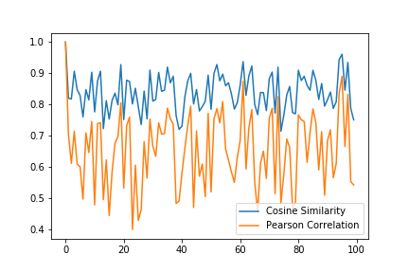
Comparison of this two Similarity Measurement
This graph shows the comparison of the output of this two measurements. This output is generated by comparing the
Similarities of other users including first user with the first user

Slide 5
Discussion

